Slide 1


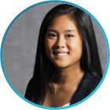






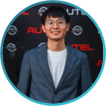
Pecha Kucha 2 – From idea to production
Group 4
Amadou, Anouar, Dennis, Gregor, Linyan, Magdalena, Melina, Nils, Thu, Xiaogang

Slide 2

Outline for today
First achievements and organizational structure
Research topics and ML techniques
ML pipeline and TFX
Next steps
Notes:
Let‘s first have a look at todays outline:
We‘ll start by reviewing our achievements and organizational structure.
I’ll then dive into promising ML research and corresponding techniques.
Afterwards Linyan will explain our ML pipeline, tensorflow extended and our next steps.
Since our last Pecha Kucha, we set up our organizational structure on Jira and our software infrastructure including the CI/CD & Docker setup.

Slide 3



What has been achieved since the last time?
Confluence Wiki and Jira setup done
Docker setup completed
CI/CD setup is being implemented
Coding environment setup defined (auto-formatter, VS Code packages, coding style alignment)
First overview of project data done
◻︎ Outline | ◼︎ Organizational structure | ◻︎ Research Topics | ◻︎ ML Pipeline | ◻︎ Next steps
Notes:
Since our last Pecha Kucha, we set up our organizational structure on Jira and our software infrastructure including the CI/CD & Docker setup.
We also aligned on a common coding environment & guidelines like the coding style.
Lastly we reviewed the given project data.
Going forward we decided to conduct weekly all hands meetings to update each group member about the progress of each subgroup and review and assign responsibilities.

Slide 4
How do we move forward?
All-hands meeting every Monday for updates
Regular updates for the complete group
Assigning tasks and responsibilities
Review equal task load assignment
Additional topic specific meetings in smaller groups
Detailed review of specific problems
Paper reading circle
Presentation and discussion of relevant research topics
Documentation of results on Wiki
◻︎ Outline | ◼︎ Organizational structure | ◻︎ Research Topics | ◻︎ ML Pipeline | ◻︎ Next steps
Notes:
Going forward we decided to conduct weekly all hands meetings to update each group member about the progress of each subgroup and review and assign responsibilities.
Additionally we started a paper reading circle where each group member will present a promising approach we see useful for the given task.
All our findings and meetings are documented in our wiki.

Slide 5
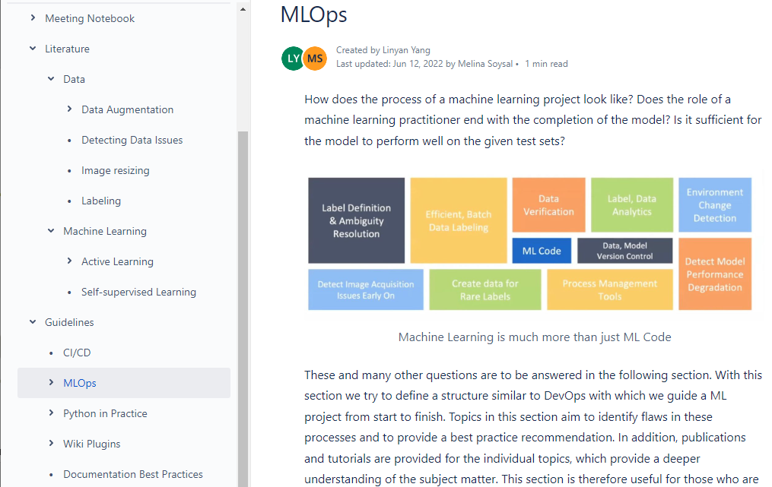
We use the wiki to document all of our work
Meeting Notes
Literature
Guidelines
◻︎ Outline | ◼︎ Organizational structure | ◻︎ Research Topics | ◻︎ ML Pipeline | ◻︎ Next steps
Notes:
All our findings and meetings are documented in our wiki.
The wiki is divided into three sections:
Our meeting notes, a section for literature review and guidelines and best practices on our selected tools.
The crutial feature of our wiki is the ability to trace back contributions and gained knowledge of individual team members.
We now want to dive into the technical part of the project.

Slide 6



Problem setting: What data are we dealing with?
Task: Categorize car damages
Pictures with / without car
JSON entries random or carefully selected?
41674
No JSON entry
Possible labelling
dent
dent
With JSON entry
With bounding box
scratch
scratch
51259
rim
rim
9585
897
Pictures with car
other
other
Damage bounding box
◻︎ Outline | ◻︎ Organizational structure | ◼︎ Research Topics | ◻︎ ML Pipeline | ◻︎ Next steps
Notes:
We now want to dive into the technical part of the project.
We received several pictures of cars and the task is to classify possible damages.
For some images of the dataset we are given an additional json file entry and for a further subset we are given bounding boxes.
However, the bounding boxes only take up a very small area of the frame as you can see on this slide.

Slide 7

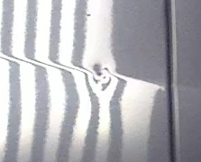
Problem setting: Obvious class imbalances
Most damages take up very small areas of the whole frame
Data with actual damages very limited
Problem setting quite complex
Data augmentation to increase size of training data
◻︎ Outline | ◻︎ Organizational structure | ◼︎ Research Topics | ◻︎ ML Pipeline | ◻︎ Next steps
Notes:
However, the bounding boxes only take up a very small area of the frame as you can see on this slide.
Additionally the data with actual damages in the picture is rather limited.
This makes the whole problem setting very complex.
We therefore started to investigate techniques like data augmentation to increase the size of our training data set.
In data augmentation we add slightly modifies versions of our original dataset to enrich it.

Slide 8
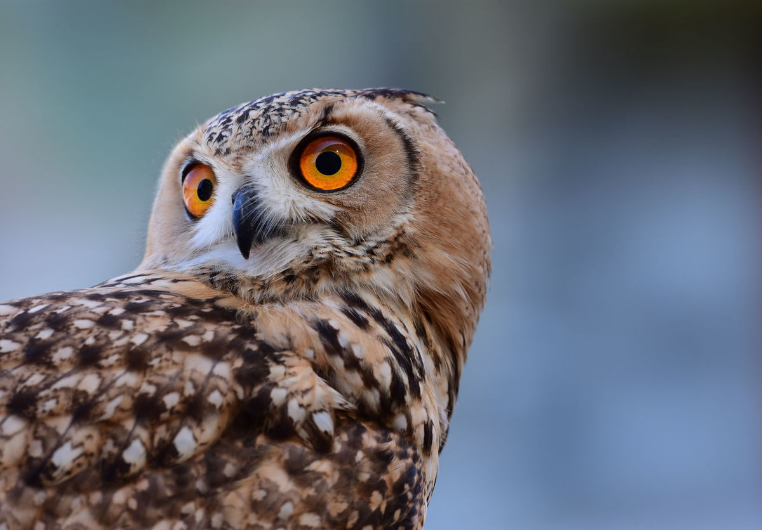
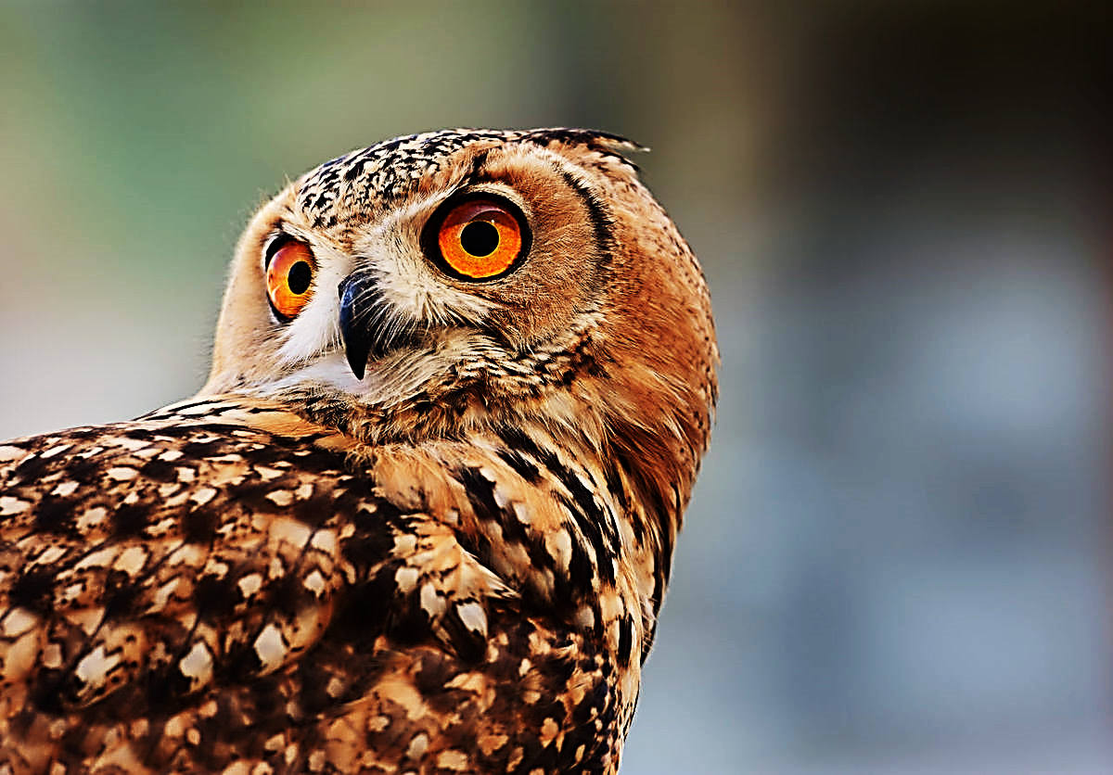
Data Augmentation enriches the dataset
Cropping
Shifting
Original Image
Flipping / Mirroring
Local warping
Shearing
….
Zooming
Coloring
◻︎ Outline | ◻︎ Organizational structure | ◼︎ Research Topics | ◻︎ ML Pipeline | ◻︎ Next steps
Notes:
In data augmentation we add slightly modifies versions of our original dataset to enrich it.
This acts as a regularizer and helps to reduce overfitting.
We plan to try various techniques like flipping, zooming, shifting the colorspace to compare their influence on the models performance.
As the input of a ML model must always be the same size, we also need to resize the data for the respective pixel ratio and size.

Slide 9
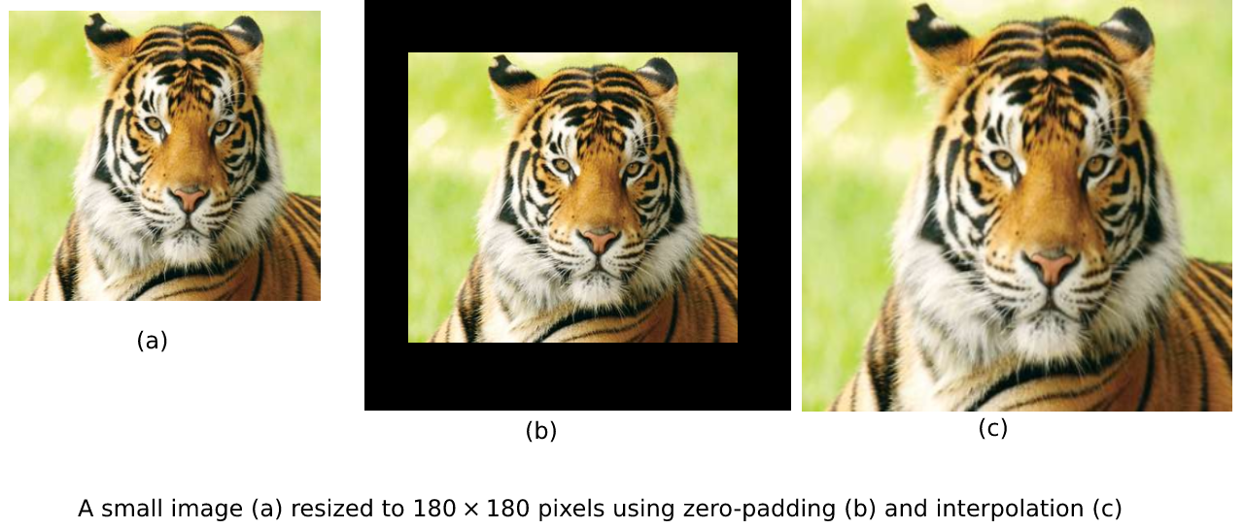

Image resizing always bears risks
Image smaller than fixed size
Scaling: risk of deforming pattern
Zero-padding: pattern preserved + faster calculations
original
up scaling
(interpolation)
zero-padding
Image larger than fixed size
Cropping: risk of losing feature
Scaling: risk of deforming pattern less severe
original
cropping
down scaling
◻︎ Outline | ◻︎ Organizational structure | ◼︎ Research Topics | ◻︎ ML Pipeline | ◻︎ Next steps
Notes:
As the input of a ML model must always be the same size, we also need to resize the data for the respective pixel ratio and size.
If the image is too small, it should rather be zero padded than upscaled.
For images too large down scaling is preferred over cropping to prevent the risk of losing features.
In General when dealing with datasets, it is important to detect data issues like an unbalanced dataset early.

Slide 10
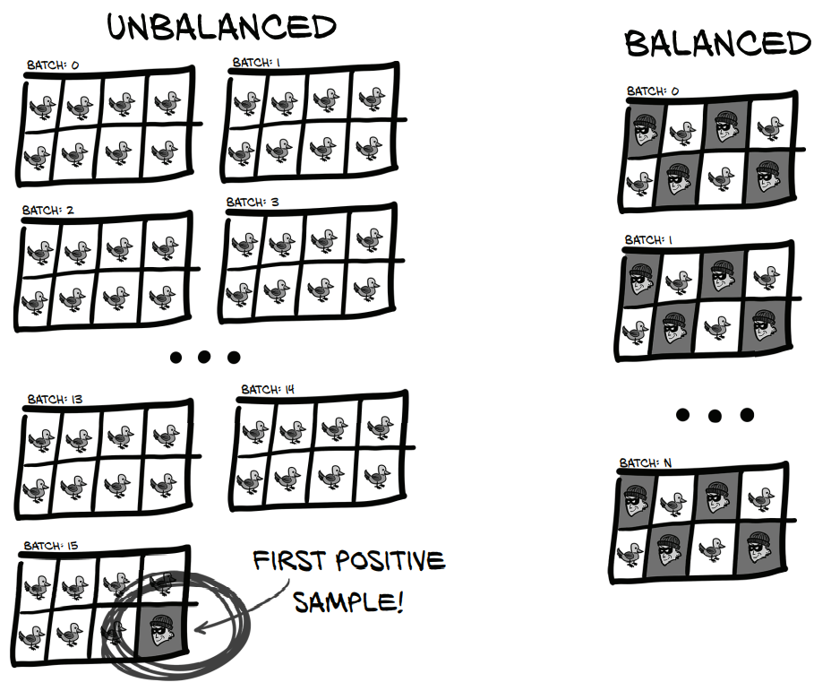
Detecting data issues
Unbalanced dataset
Scalability for active learning
Interconnection between model and label
Data can make or break a model
◻︎ Outline | ◻︎ Organizational structure | ◼︎ Research Topics | ◻︎ ML Pipeline | ◻︎ Next steps
Notes:
In General when dealing with datasets, it is important to detect data issues like an unbalanced dataset early.
When using active learning we must be additionally aware of scaling and label interconnection issues.
As data can make or break our model we decided to focus on high quality data from the start.

Slide 11
Reducing the need for manual labeling with active learning
Strategies we want to apply:
Model
Data labeled by model
Uncertainty-based approach
Diversity-based approach
Hybrid query strategies
Labeled Data
Unlabeled Data
…
Explore representativeness vs. informativeness trade-off
Oracle
◻︎ Outline | ◻︎ Organizational structure | ◼︎ Research Topics | ◻︎ ML Pipeline | ◻︎ Next steps

Slide 12
Exploiting knowledge with transfer learning
Traditional Machine Learning
Transfer Learning
Strategies we want to apply:
train
train
Obtain knowledge learned in one source task
Use it to improve learning in another related task
Freeze weights
Dataset One
Exploit the knowledge gained from similar tasks.
Dataset Two
◻︎ Outline | ◻︎ Organizational structure | ◼︎ Research Topics | ◻︎ ML Pipeline | ◻︎ Next steps

Slide 13

Using self supervised learning to learn a good representation from unlabled data
1
Design a simple proxy-task and train the model on unlabeled data
2
Fine tune the model on a small labeled dataset for the specific task
Class: Scratch!
Same picture?
Leveraging unlabeled data sources
◻︎ Outline | ◻︎ Organizational structure | ◼︎ Research Topics | ◻︎ ML Pipeline | ◻︎ Next steps
Notes:
Take unlabeled dataset and define a proxy task that is easy to implement
Train the neural network on this proxy task to generate a pre-train model (This model will already know some features that the actual task needs)
Train the pre-train model with a few labeld samples get a beter model for the downstream task, the task that it actually is wanted
Pro: No prior labeling needed

Slide 14




We organize our findings in a MLOps Pipeline
We will use TFX for our pipeline
TFX can be used with:
Data collection
Experimentation
Tuning
Serving
And more…
◻︎ Outline | ◻︎ Organizational structure | ◻︎ Research Topics | ◼︎ ML Pipeline | ◻︎ Next steps

Slide 15
Keeping the ML development organized!
Which dataset has been used?
Which values had the hyperparameters?
What caused a failure?
ML Metadata Store
Which pipeline structure has been used?
How do the implementations compare?
◻︎ Outline | ◻︎ Organizational structure | ◻︎ Research Topics | ◼︎ ML Pipeline | ◻︎ Next steps
Notes:
When using picture please refer the source

Slide 16
TFX encapsulates fuctionalities inside components
TFX Component
Driver
Coordinates job execution
Executer
Performs the work
Publisher
Updates ML metadata
fetch
publish
ML Metadata Store
◻︎ Outline | ◻︎ Organizational structure | ◻︎ Research Topics | ◼︎ ML Pipeline | ◻︎ Next steps
Notes:
- First we need configuration for our component (still missing in the image)
- We need a place to send information -> Metadata store
- Read metadata from previous components and write metadata for next components

Slide 17
We will use TFX to keep our ML Pipeline organized
Data Ingestion
Data Validation
Data Processing
Estimator on Keras Model
Model Analysis
Model Serving
ExampleGen
StatisticsGen
Transform
Tuner
Evaluator
Model Server
Read data
Analyzes data
Hyperparameter
SchemaGen
Trainer
Get data properties
◻︎ Outline | ◻︎ Organizational structure | ◻︎ Research Topics | ◼︎ ML Pipeline | ◻︎ Next steps
Notes:
TFX:
Pipelines: sequence of components (driver, executor and publisher), basically only customize executor which performs the work
Example gen reads in data, splits into training and eval, formats as tfexamples
Statistics gen: does one full epoch and calculates statistics of data, find possible issues
Schema gen: looks at statistics and tries to infer type per feature and range of categories
Example Validator looks for anomalies, missing values etc
Transform for feature engineering: vocabs, PCA etc
Trainer trains model and save normal savemodel and evalsave model to analyze performance
Tensorboard to analyze and monitor training runs based on meta data store
Evaluator for deep model analysis on individual slice basis
Model validator decides if modle Is good enough to be pushed, Pusher then pushes model

Slide 18
The TFX flow covers the whole pipeline
Data Ingestion
Data Validation
Data Processing
Estimator on Keras Model
Model Analysis
Model Serving
ExampleGen
StatisticsGen
Transform
Tuner
Evaluator
Model Server
Data
Read data
Analyzes data
Hyperparameter
SchemaGen
Trainer
Get data properties
TFX Pipeline
◻︎ Outline | ◻︎ Organizational structure | ◻︎ Research Topics | ◼︎ ML Pipeline | ◻︎ Next steps
Notes:
Schema gen: looks at statistics and tries to infer type per feature and range of categories

Slide 19
TFX Serving allows a seamless processing of the given tasks
Volume
ML Metadata
TFX Pipeline
File System
TFX Serving
Active Learning / Model retraining
port=8888
JSON
response
REST API request
Prediction
Input Image
Label
Client
◻︎ Outline | ◻︎ Organizational structure | ◻︎ Research Topics | ◼︎ ML Pipeline | ◻︎ Next steps

Slide 20
TFX
Set up TFX in our repository and make every team member familiar with it
Next steps
Research
Continue research and reading circle on techniques that could be used in our project
Data
Further inspection and preprocessing of given data
Apply our research to the given data
◻︎ Outline | ◻︎ Organizational structure | ◻︎ Research Topics | ◻︎ ML Pipeline | ◼︎ Next steps

